Slide 1
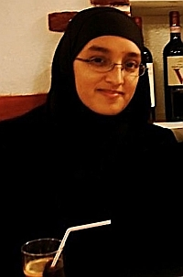
Roshonara Choudhry
Gender AND her online radicalisation
VoxPol august 2014

Slide 2
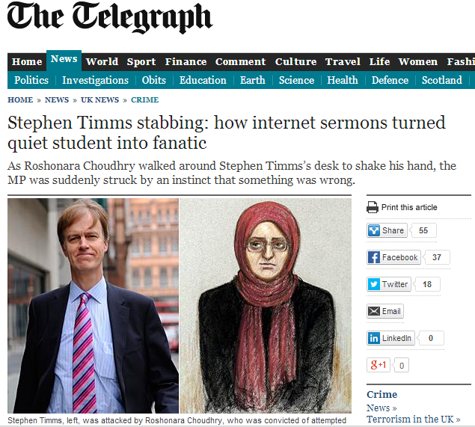
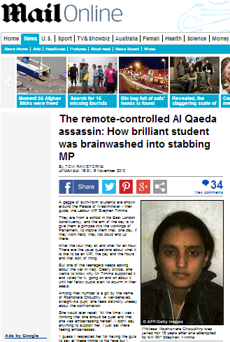
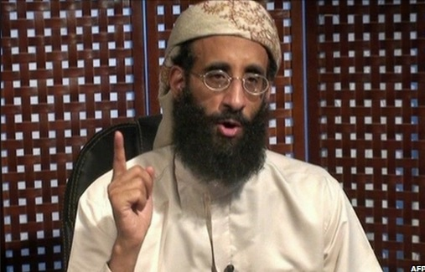
Significance
King’s Student
Stabs Stephen Timms MP May 2010
Lone wolf violent radicalisation took place online
Blamed on Al Awlaki
Only woman in UK convicted of such crime
“Roshonara Choudhry may represent the changing face of violent extremism in a younger generation that is increasingly looking toward the internet for answers” (McFarlane 2010)

Slide 3
Definitions
'Radicalisation' 'an increase in and/or reinforcing of extremism in the thinking, sentiments, and/or behavior of individuals and/or groups of individuals‘ (Mandel 2009)
‘Violent radicalisation', radicalisation that includes “a willingness to support or engage in violent acts” Dalgaard-Nielsen (2010)
'Home-grown' terrorism: violence targeting 'Western countries in which the terrorists themselves have been born or raised.' Precht (2007)
Jihad: the lesser jihad, the violent struggle for Islam; it is a key concept in Islamism, the, 'literalist practice of Islam with a revolutionary political ideology‘ Sageman (2004)
'Gender' - roles and norms associated with masculinity and femininity, malleable, socially constructed and dependent on context (Butler 1999)

Slide 4
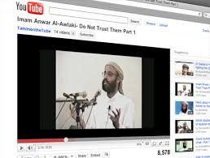
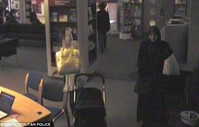
Timeline
Late 2009 – 1st YouTube videos of Al Awlaki downloaded
100 hours of sermons
RevolutionMuslim forum site
Sheikh Abdullah Azzam video
April 2010 – drops out of studies at King’s
Identifies Timms on Theyworkforyou.com
May 2010 – buys kitchen knives
hides them under her bed
May 14th 2010 – Beckton, stabs Timms MP

Slide 5
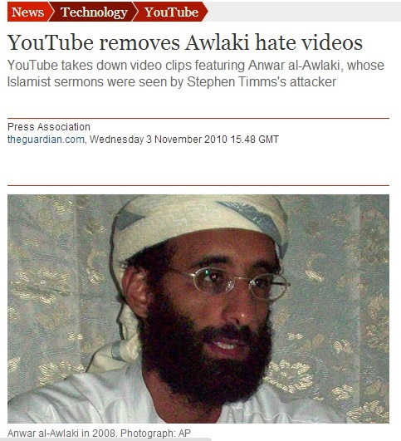
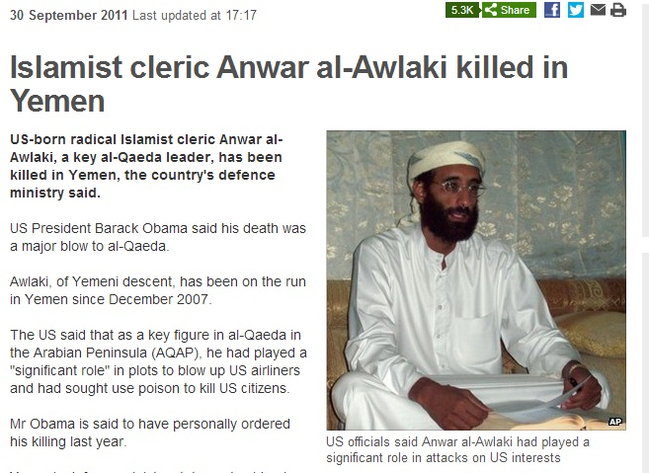
Consequences Focus on Al Awlaki and the Net

Slide 6
Consequences Focus on the Lone Wolf
Threat Perception
President Barack Obama 2011
“The most likely scenario that we have to guard against right now ends up being more of a lone wolf operation than a large, well-coordinated terrorist attack.”
Debate and Focus
The search for a typology:
‘Lone wolf' vs 'loner' attacks (Pantucci 2011)
‘Lone wolf' - free from direct organisational support. (Spaaij 2010)

Slide 7
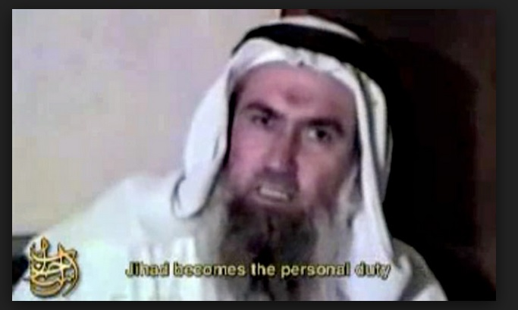
Abdullah Azzam
Q OK, can you pinpoint the time when that changed or was it a gradual ... was there one particular incident?
A Like, erm, after like listening to the lectures, I realised by obligation but I didn't wanna like fight myself and just thought other people should fight, like men, but then I found out that even women are supposed to fight as well so I thought I should join in.
Q Where did you find that out from?
A A YouTube video by Sheikh Abdullah Azzam.
“If, however, the enemy attacks a port or enters into a Muslim town, jihad … becomes an individual obligation (fard ‘ayn)…. In such a case, [the requirement] to seek permission becomes void and the traditional authority structures cease to apply .. a boy is permitted to go out to fight without his father’s permission, a wife without the permission of her husband, and he who is in debt without the permission of his creditor” Azzam

Slide 8
Real world and gender
“Lone wolves do not radicalise in a vacuum”. (Spaaij 2010:866)
How did the real-world factor in this apparently online radicalisation?
Does it make a difference that Choudhry is a woman?
Is gender a factor?

Slide 9
Home-grown radicalisation
Wiktorowicz – studies of Al Muhajaroun (Wiktorowicz 2005)
Relative deprivation – socio-economic – particularly Pakistani-Bangladeshi
‘Upwardly mobile’ students
Students with little prior knowledge – ‘seeking personal religious identity’
‘cognitive opening’
Sociological theories:
Roy, Kepel and Khosrokhazar - alienation in second or third generation Muslims living in the West. “Double sense of non-belonging”.
Roy (2003) Dalgaard-Nielsen (2010:799)

Slide 10
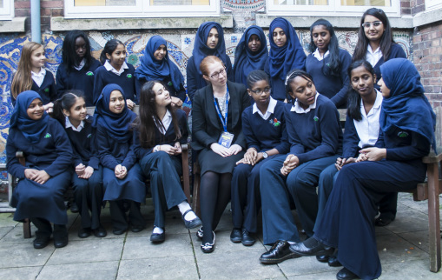
Choudhry’s background
Family
Muslim
Bangladeshi father, British Bangladeshi mother
Father unemployed tailor and taxi driver
Family on benefits
Roshonara is eldest of five
Earns £ through private tuition
Straight-A student

Slide 11
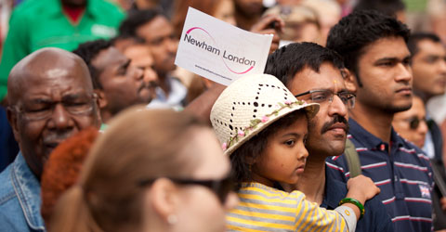
Choudhry’s background
Geography
Hizb ut-Tahrir targeted Newham mid 1990s (Hussein 2007:129-39)
Newham: second most deprived borough in England
Half children live in poverty
Poverty disproportionately affects large Pakistani and Bangladeshi communities. Via Newham Local Economic Assessment, p.1 & p.10, http://www.newham.info/Custom/LEA/Demographics.pdf
King’s College London: 1 case of radicalisation
2003

Slide 12
Next Stage
Collective
Many theories
“Socialisation” is key:
Of twelve mechanisms to political radicalisation, McCauley and Moskalenko recognise only two as autonomous. McCauley & Moskalenko (2008)
Dalgaard- Nielsen: three types of explanation of terrorism –group dynamics key to all (Dalgaard-Nielsen 2010)
Silber and Bhatt “Association with like-minded people is an important factor as the process deepens” (Silber and Bhatt 2007)
Wiktorowicz “social networks are often critical for recruitment” (2005)
Sageman “Bunches of Guys” - social bonds matter (Sageman 2008)

Slide 13
Police Interviews “..I wasn't searching for him, I just came across him ”
Hussain How did you come across him?
A On the internet.
Hussain Was that from your own research or did someone recommend him?
A From my own research but everybody listens to him and likes him anyway.
Q Do you go to a regular mosque?
A No ... I just pray at home.
Q Who do you discuss your Islam with?
A In general I just talk about it to my brothers and sisters but I don't mention everything to them.
Q If you've got a question that you want to ask or you want answered, who do you ask?
A I don't ask anyone I just listen to his lectures. There's no one to ask.
(Dodd – The Guardian)

Slide 14
Gender in Real World Challenge to Knowledge-seeking in Mosques
“It's not surprising Roshonara Choudhry learned her faith from the internet”
Sara Khan, INSPIRE
The practicalities of religious identity exploration for young British Muslim women are complex and highly gendered (Afshar et al 2005)
Few real-world locations that encourage religious exploration, or participation, on women's own terms (Siddique 2011)
¼ mosques do not admit women; many others segregated (Bowen 2014)
“Respondents who had visited mosques outside the UK commented on the differences, and suggested that UK mosques stand-out in not providing spaces for women” (Shannahan, Inclusive Mosque Initiative)

Slide 15
Gender and Real-world Religious Exploration Challenges to finding women’s spaces
British Muslim women and identity
Men and women negotiating faith and identity in different ways
Research with young Muslim men has seen them using religion to create control
'policing' female behaviour, asserting dominance. (Archer cited in Choudhury 2007 p.11; Choudhury 2007 p.10; Hopkins 2008 p.79)
Research with young Muslim women:
Islamic identity = source of liberation from patriarchal norms (Dwyer 2000)
Women negotiating different identities imposed on them, as ‘oppressed’ or objects of hostility (Afshar et al 2005; Afshar 2008; MacDonald 2006)

Slide 16
Gender and Real World Radicalisation Identity Politics
Islamism
Islamist groups projecting highly masculinised combative identities (Afshar et al 2005; Venhaus 2010)
Women cast in supportive roles.
Radical organisations actively include women in non-violent roles. (Wiktorowicz 2005)
Which women may not want to accept (Afshar et al 2005)

Slide 17
Gender and the net
More activity from women on the internet in chat-rooms (Sageman 2008)
Internet as a deboundaried space (Briggs & Strugnell 2011)
Also those with little knowledge more vulnerable (Lee & Leets 2002)
Vs Sageman – the danger is to ‘already made-up minds’ (Sageman 2009)
Greater extremism + higher sympathy towards political violence than men (Bermingham et al 2004)
Utilising social disinhibition (Suler 2004)
Women are specifically targeted (AVID 2012)
Net works as milieu/community (Briggs & Strugnell 2011:1; Holtman 2011:2)
One in which women can more easily take stronger role

Slide 18
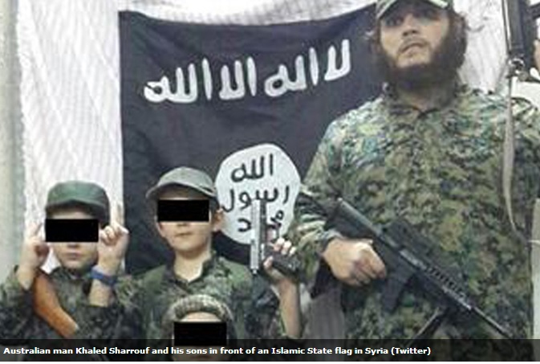
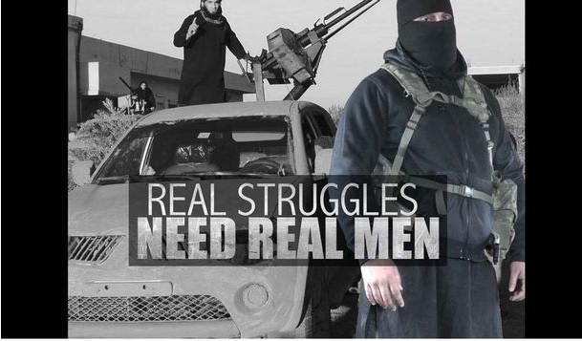
Gender as Limitation on violence
Gendered nature of real world groups
‘..masculine conception of heroism among terrorists'
Suicide bombers are the 'ultimate Jihadi warrior hero‘
(Sageman 2008)
Syria and Iraq (Social Media imagery and messaging)
Violent jihad prohibited for women, predominantly
(Lahoud 2014; Cook 2006)

Slide 19
Dissonance
This disconnect/'dissonance' between online and offline identities one of six key dynamics of radicalisation online (Neumann 2012)
Dissonance is tension arising from a lack of cohesion between identities
Alleviating tension Real world violence (Brachman & Levine 2011)
Tension: restrictions of gender norms prohibiting jihad vs desire to take part in violence
LIBERATED by Azzam

Slide 20
Conclusion
Gender does matter in Choudhry’s radicalisation
It was a challenge to a real-world engagement with her Islamic identity
Possibly pushing her to explore extremism on the internet
On the net it made her susceptible to well-framed extremist online messages
Gender inhibited real-world action
Increasingly intolerable dissonance between her online extremist identity and her 'real' identity
Identities united by Abdullah Azzam: prompts the violence by liberating her from gender restraints
Radicalisation has real world roots
Choudhry does exercise agency in her own radicalisation – not brainwashed by YouTube

Slide 21
Limitations
Don’t know to what extent mental health issues factor
Don’t know full extent of Roshonara’s offline influences

